Slide 1
Navigating the Con. App. for l4GA 2019 First timers
Or—Helping Literacy People Pretend to be Math People
Vince Frosteg
Director of Teaching & Learning
Pelham City Schools
vfrosteg@pelham-city.k12.ga.us / (229) 294-8715 x101

Slide 2
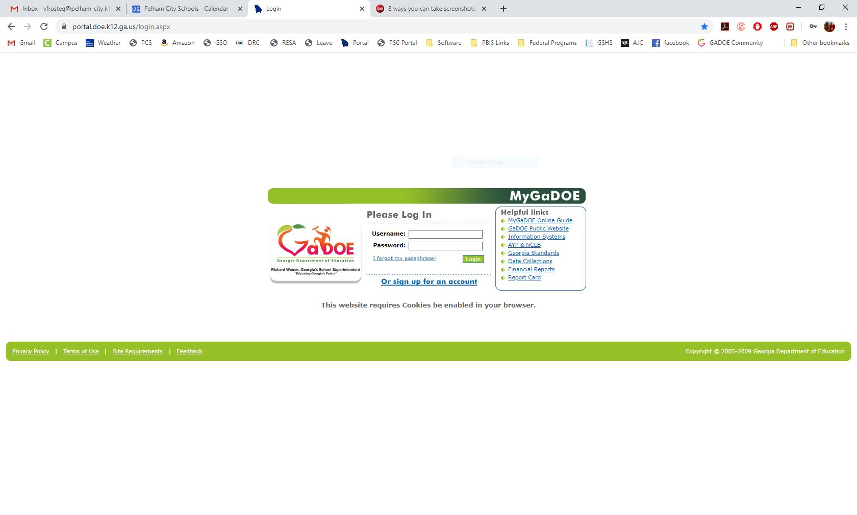
To access the Consolidated Application, you’ll need to navigate to the MyGaDOE Portal (portal.doe.k12.ga.us).
If you aren’t sure about your credentials or don’t have any, you’ll need to have your district’s portal security person request access for you from GaDOE. (This is probably your Finance Director or IT Director.)

Slide 3
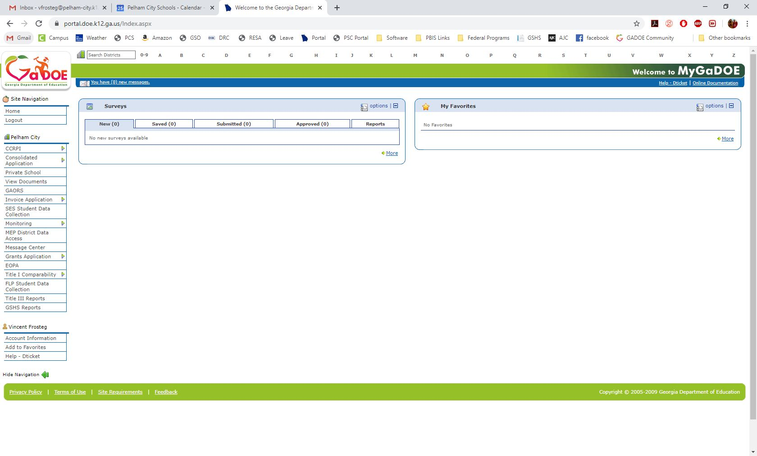
We’ll tackle the budgeting part of the ConApp first. Once you’re in the portal, you’ll see all the areas you have access to on the left sidebar. If you don’t have Consolidated Application (and Title Programs as a subcategory) and Grants Application as menu items, you will need to have your portal security person request access for you from GaDOE.

Slide 4
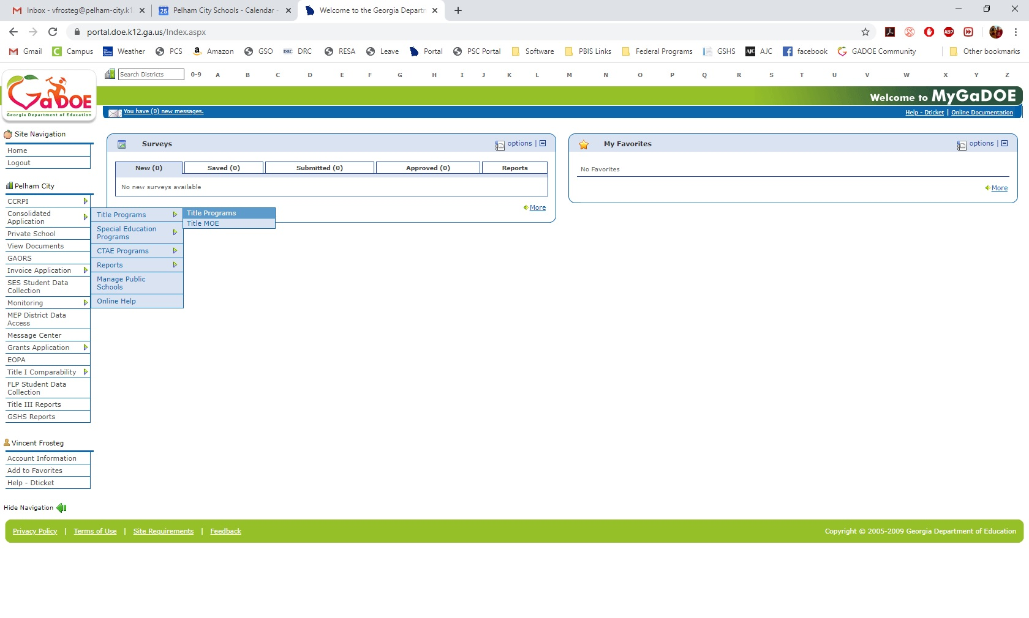
To create a budget or to create an amendment to your currently approved budget, you’ll need to select Consolidated Applications → Title Programs → Title Programs.

Slide 5
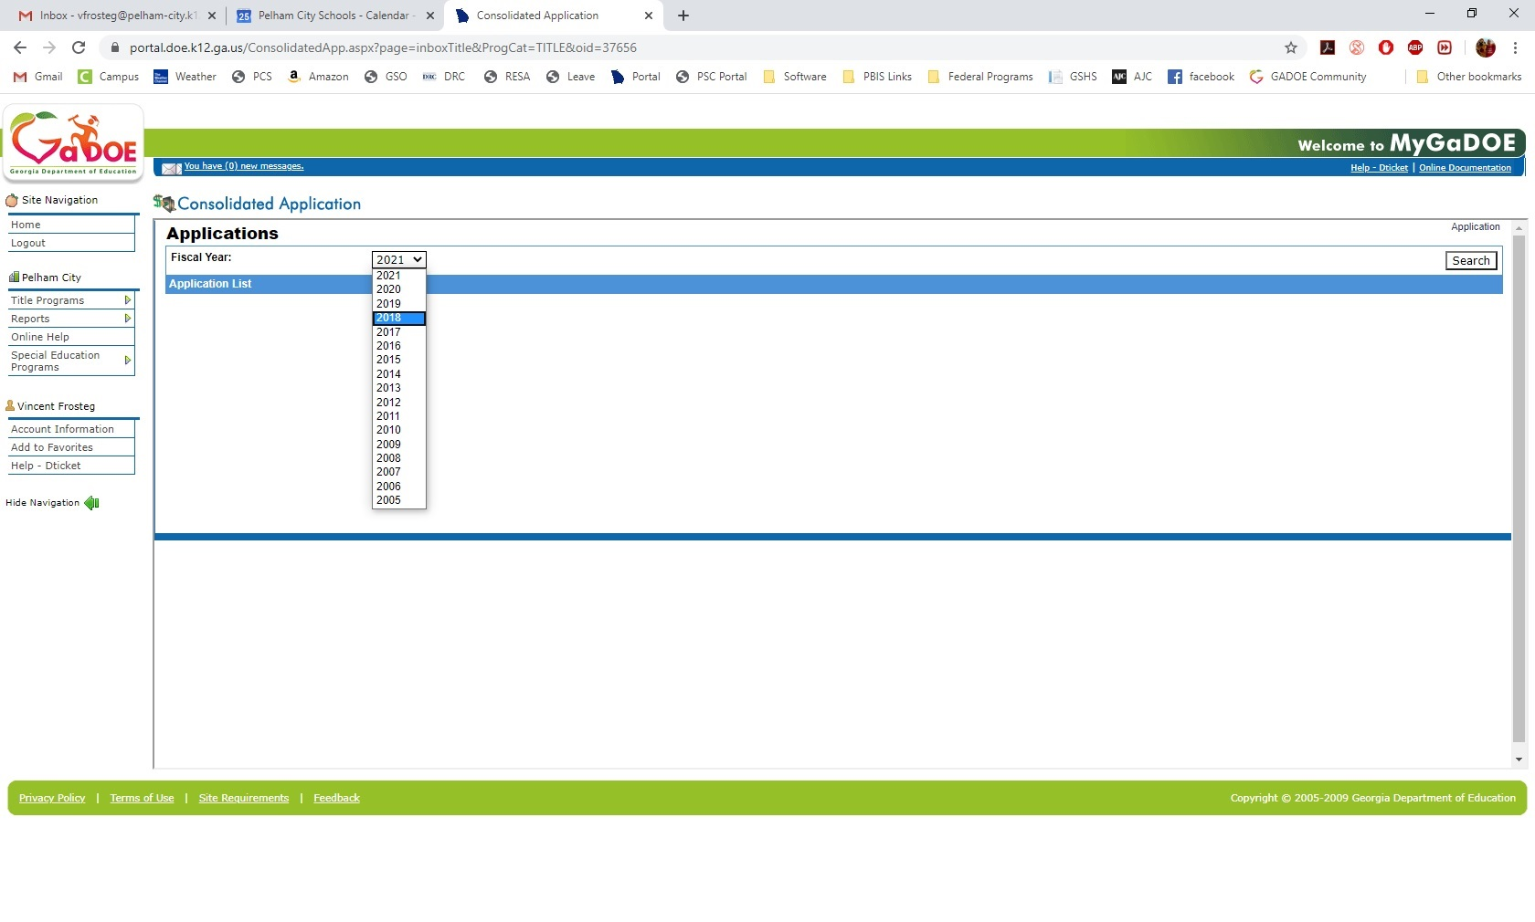
Next, select the Fiscal Year you were initially awarded the grant. Even as you move into a new fiscal year, your budgets and invoices for L4GA will remain in the FY you initially received money. (For example, all of Pelham’s L4GA budgets are still in FY18 because that was our initial year of the grant.)

Slide 6
If you received a new award with cohort Two, you will go to FY 2021 to find your grants.

Slide 7
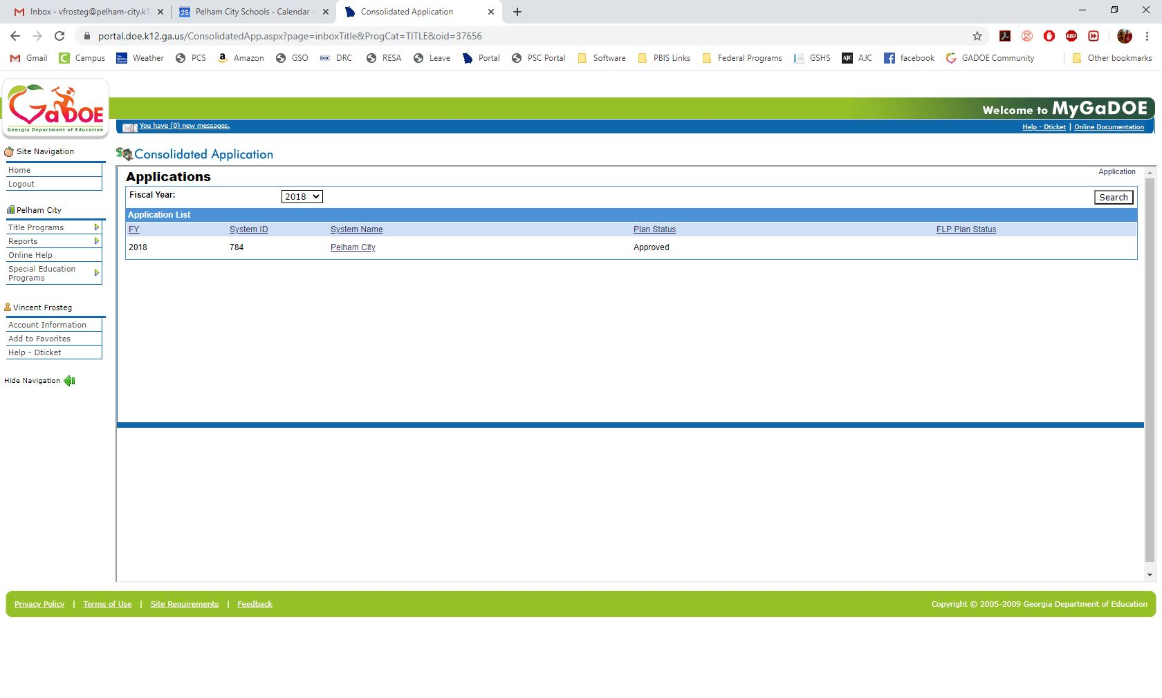
Click on your system name. (ConApp hiccup warning—sometimes the wrong system name will show up. It doesn’t happen as often anymore but it does every now and then. Just refresh and try again.)

Slide 8
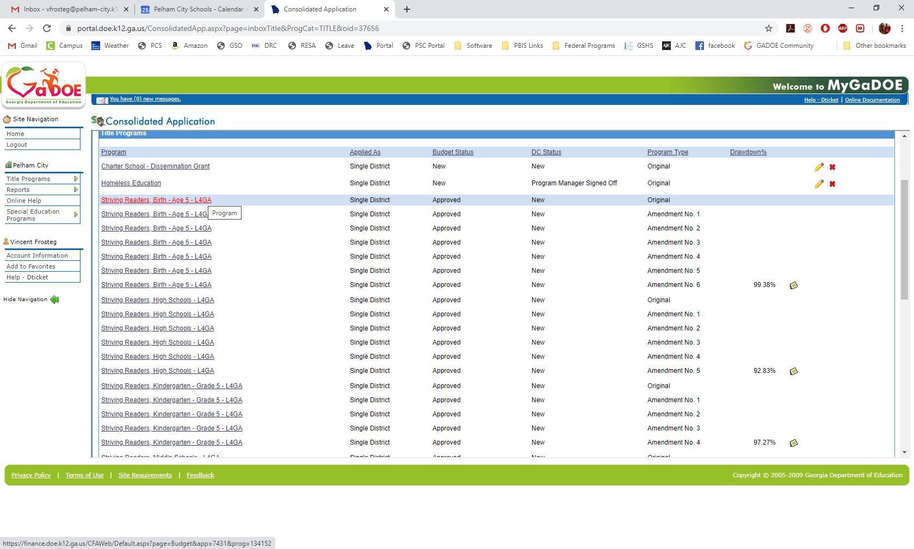
Next you’ll choose your grant program. Pelham is at the end of our grant period so our list is longer. This page will include all the amendments you’ve created not just for L4GA but for any other grants you have as well. The first time you go in, you should only see the grant and “original” listed as program type. That’s the one you’ll click on to make your budget.
If you’re creating an amendment, click on the most recently approved budget and select “Create Amendment” once you’re into the budget.

Slide 9
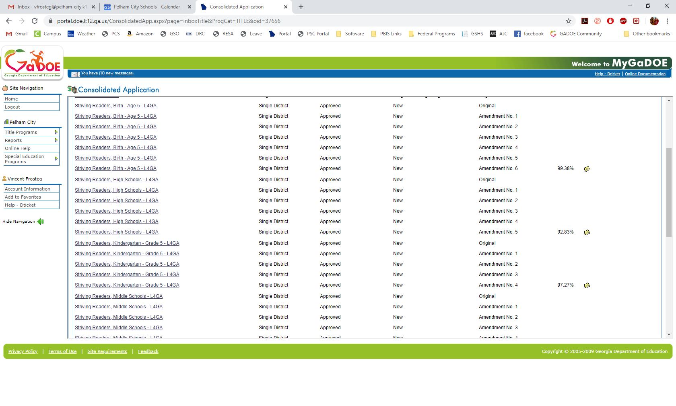
This is just an example of what our programs page looks like at the end of a grant. You will be doing lots of amendments as you adjust your spending.

Slide 10
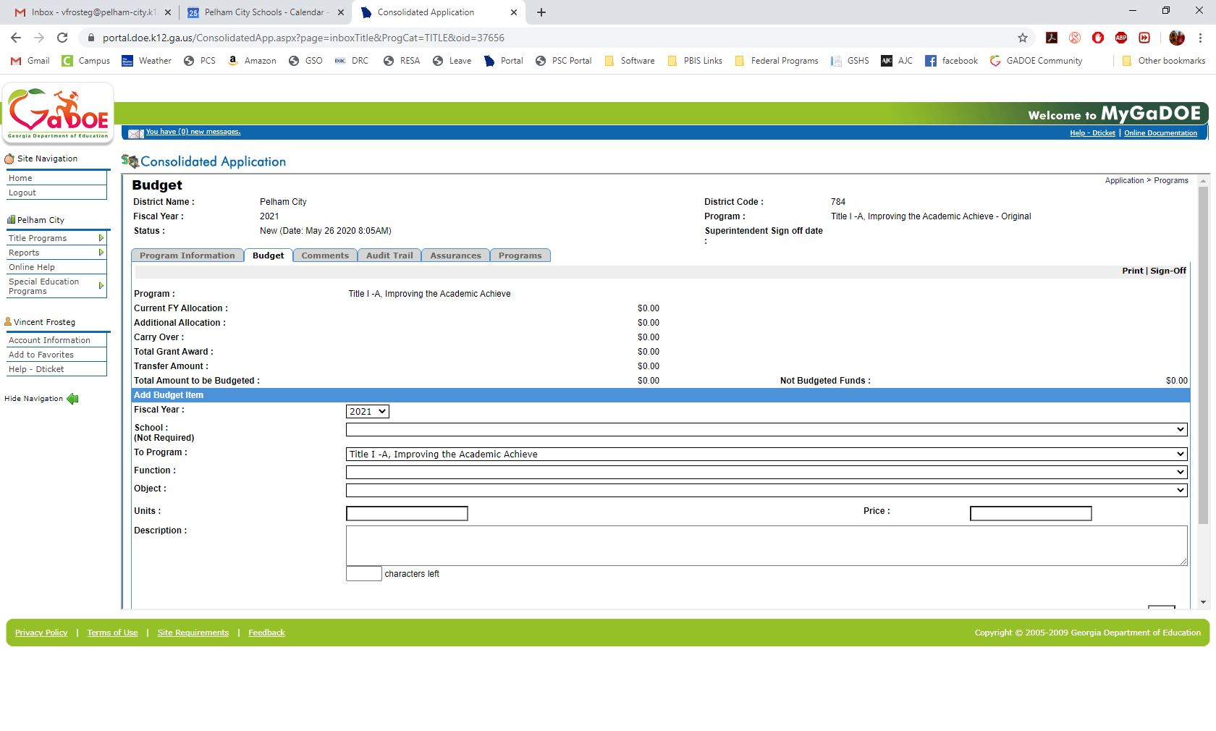
Once you’re into the program, you’ll be at the budget screen. The one shown here is blank because we don’t currently have any funds to budget.
This amount will show your total grant award.
As you create your budget, this amount will automatically adjust to show how much you still need to budget.

Slide 11
Two tips: First, numbers are entered in whole dollars. There’s no cents in the ConApp. Second, do a sample budget in Excel first so that you’re sure you have all your money where you want it to go. This will make it easier when you start putting your budget in the ConApp.
This amount will show your total grant award.
As you create your budget, this amount will automatically adjust to show how much you still need to budget.

Slide 12
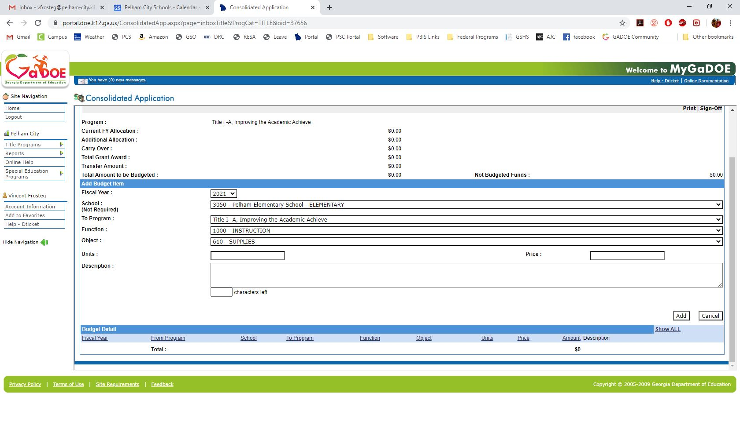
Go ahead and select your school from the drop-down. Next, you’ll need to do the function and object codes. This is the code that says what this budget item is. 1000-610 is instructional supplies.
Fill in school information.

Slide 13
Common function and object codes that you’ll probably be using—
1000-116 Stipends for Teacher Training
1000-532 Software (Q Global, Acadience, etc.)
1000-610 Instructional Supplies
1000-615 Expendable Technology Equipment (tablets, laptops, computers)
1000-642 Books & Periodicals (not textbooks)
2213-580 Travel to Workshops/Training*
2213-810 Training Registrations*
2300-300 Audit Cost (don’t forget to budget for your audit!)
*-Check with your finance people. Some systems use 2210/2213 differently.
The entire Chart of Accounts is here: http://archives.doe.k12.ga.us/fbo_financial.aspx?PageReq=FBOFinRevCOAB
Make friends with your finance and federal programs people! They’ve got function and object codes memorized.

Slide 14
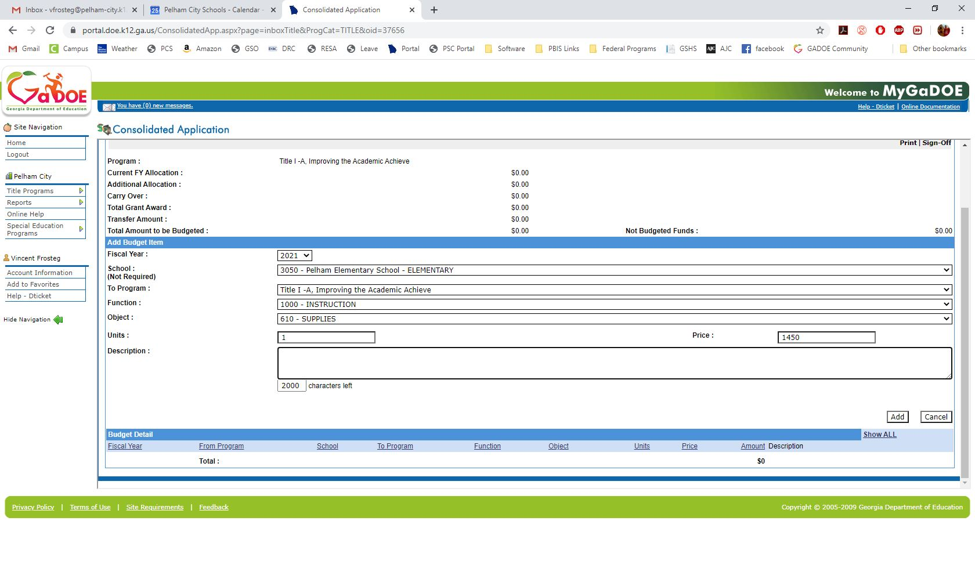
In the “Units” box you’ll list 1. Even if you’re buying 3,000 books you’ll only have 1 object code, so you’ll only have 1 unit. In the price box, you’ll put how much you’re budgeting for whatever the object code is. (In this example, instructional supplies.) You’ll likely be amending this a few times during the life of your grant.

Slide 15
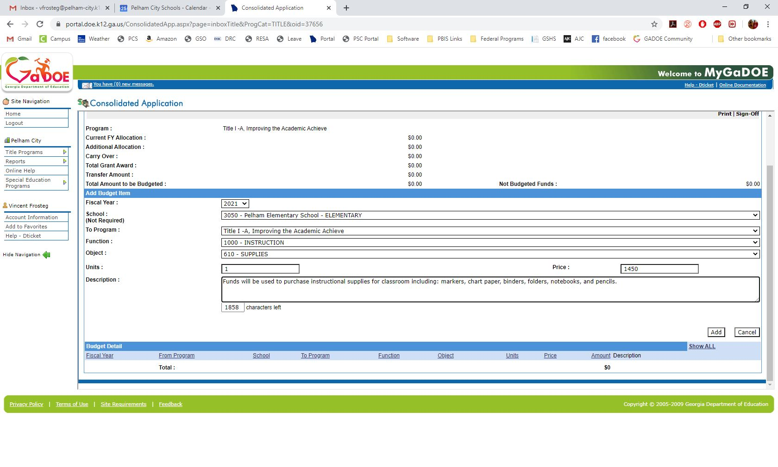
The budget description is where you’ll actually write what you’re budgeting for. (1000-610 obviously means you’ll be purchasing instructional supplies. You will need to be more direct than that in the budget description.) Avoid saying things like “etc.,” “such as,” and “including but not limited to.” List exactly what the funds will buy. (Obviously with books you won’t need to list individual book titles, but be as specific as you can.) Your Federal Programs Director will be great help with this--our program managers are very specific about what they accept.)

Slide 16
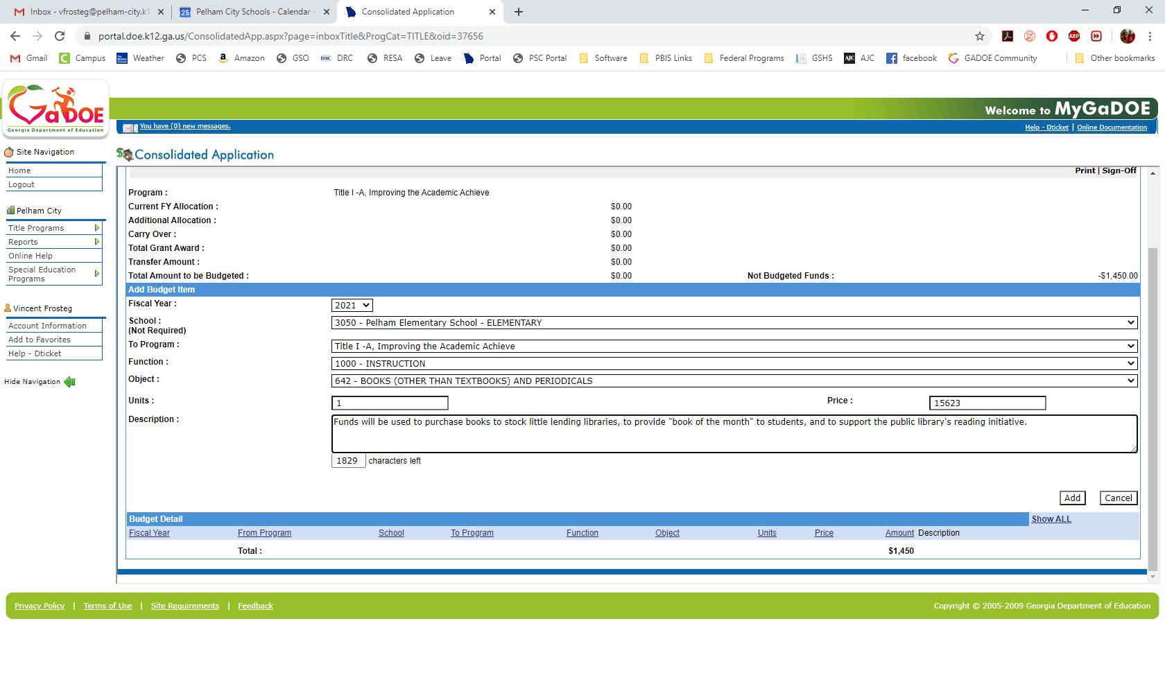
An example of how a budget description for 1000-642 (books & periodicals) may look.

Slide 17
After you have entered all of your budget items and your “Not Budgeted Funds” shows as $0, you’re ready to submit for approval. You’ll click sign-off in the top right. This will send it up the line for approval. (In small districts it may go straight to the superintendent. In larger districts it may stop at a director before it gets to the superintendent.) After it’s been signed off by your superintendent, it goes to Julie for sign-off. Any of them may return it to you for revision. You’ll get an email when that happens. If you send it off and realize you need to change something, there’s no shame in asking one of those people to reject it back to you to make corrections.

Slide 18
Once it’s signed off at the DOE level, you will need to get with your Finance Director about how purchase orders for L4GA money will come in.
In Pelham, all L4GA POs come to me after a principal. I sign off and add the amount to a spreadsheet I keep in addition to our Finance Department. This is just to help me. (If you want a copy of my spreadsheet, I can send that to you.)
After I sign-off, I pass the PO on to our Finance Department who gets the superintendent’s signature and does purchasing. I don’t do anything with our accounting system other than double-check invoices (we’re getting to that). I would definitely suggest making sure you are not the only person who touches L4GA POs. That’s a good way for everybody to keep checks and balances through the process.
Once we receive materials and vendors are paid, our finance secretary adds the invoices to the ConApp for reimbursements. She also keeps her own spreadsheet in addition to mine and the accounting software (we use PC Genesis).
Then, once a month (or however your system does it) you will need to approve the reimbursements for your funds. That’s done through another part of the ConApp called (simply enough) “Manage Invoices.”

Slide 19
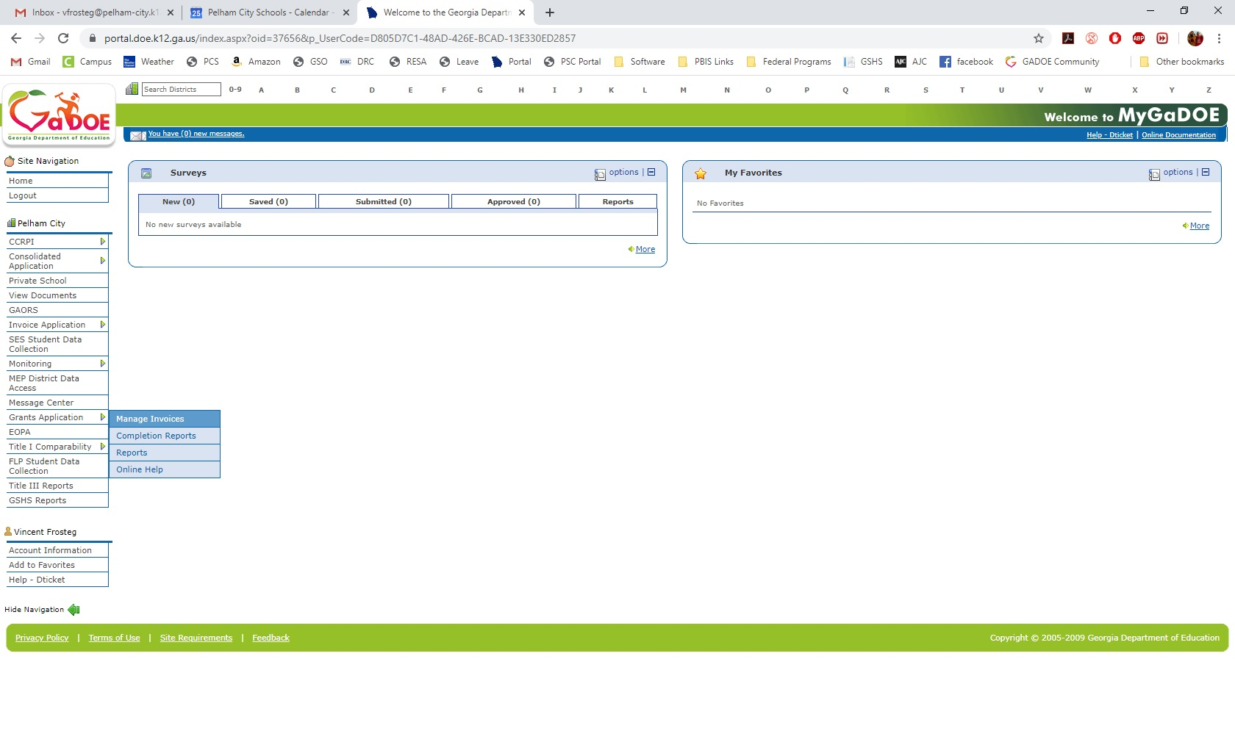
Back at the main GaDOE Portal screen, hover over “Grants Application” and select “Manage Invoices.”

Slide 20
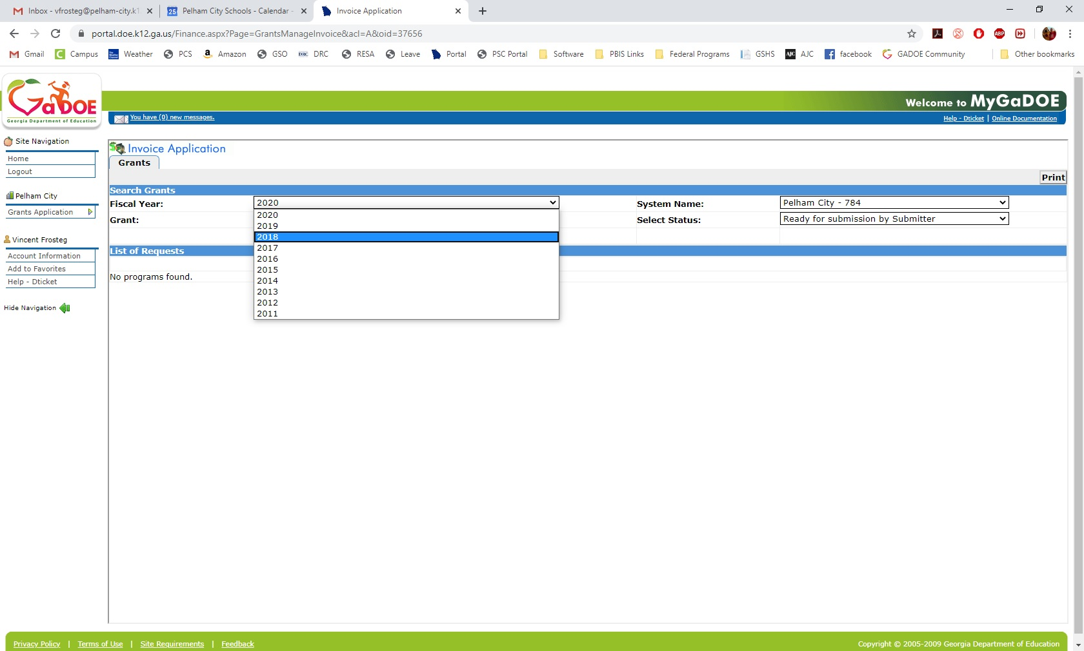
You’ll select your FY of initial funding again.

Slide 21
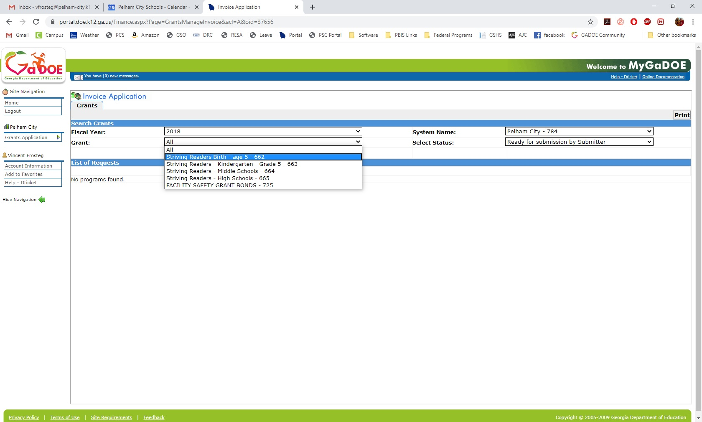
You’ll select the grant you’re going to work on first.

Slide 22
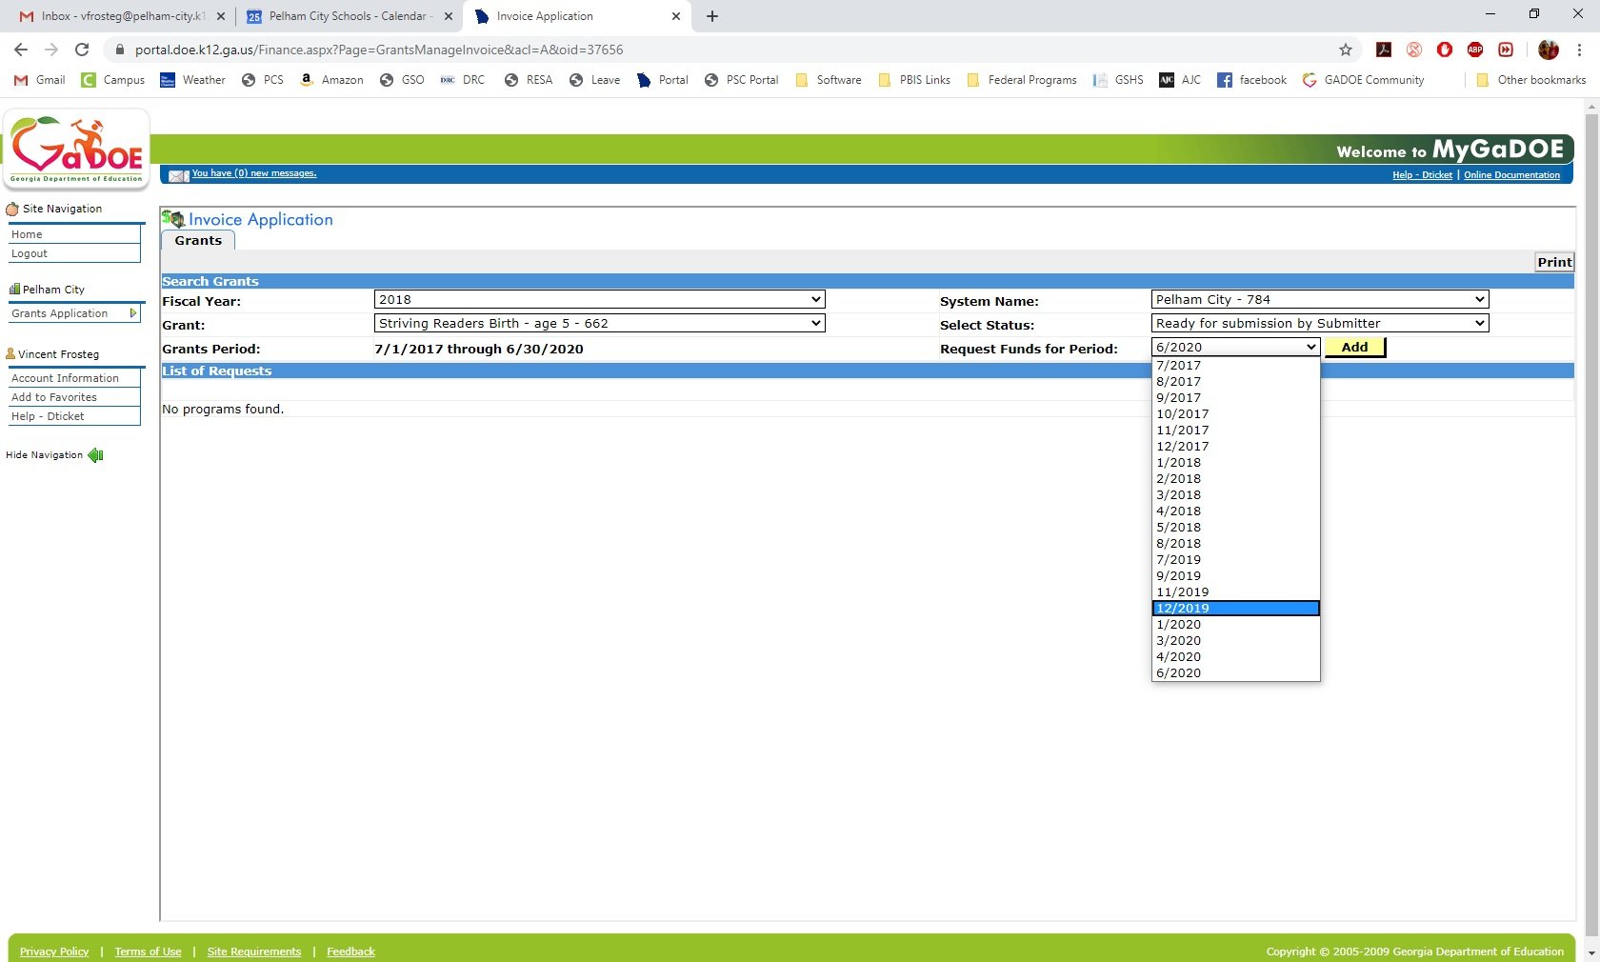
You’ll select the period; or just leave it alone if you want to see everything (that’s usually what I do).

Slide 23
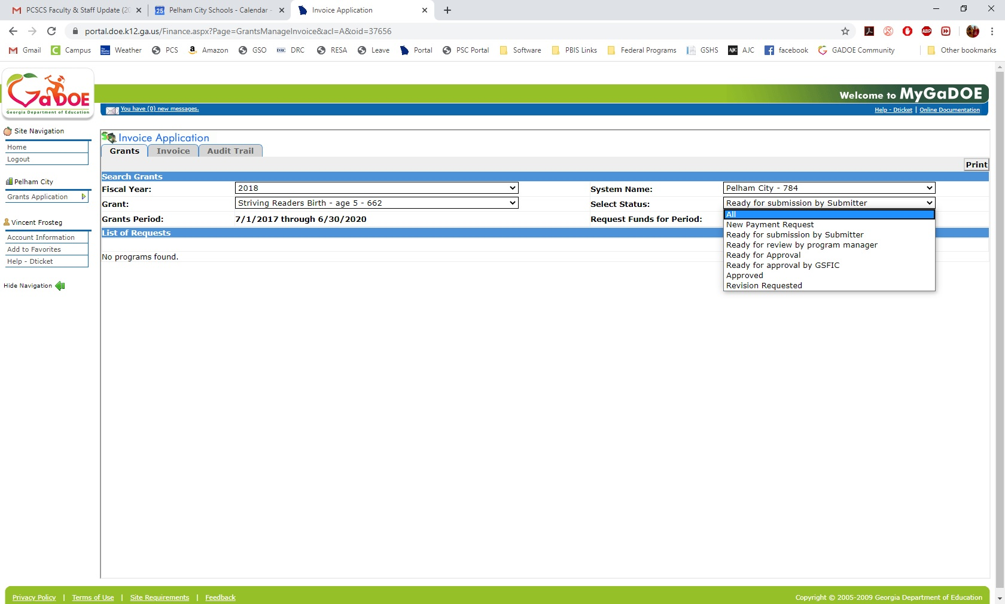
You’ll need to change the “Select Status” to “All” in order to see what’s waiting for you to sign off.

Slide 24
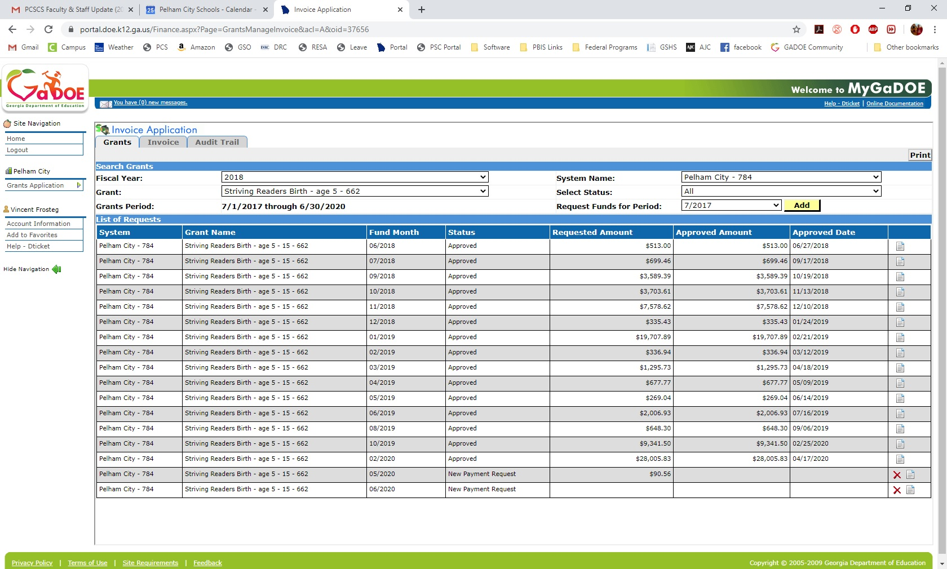
That will bring up all the reimbursements that have been approved, as well as any that are waiting for you to submit. You’ll want to click on the “view” icon of the period you’re going to approve.

Slide 25
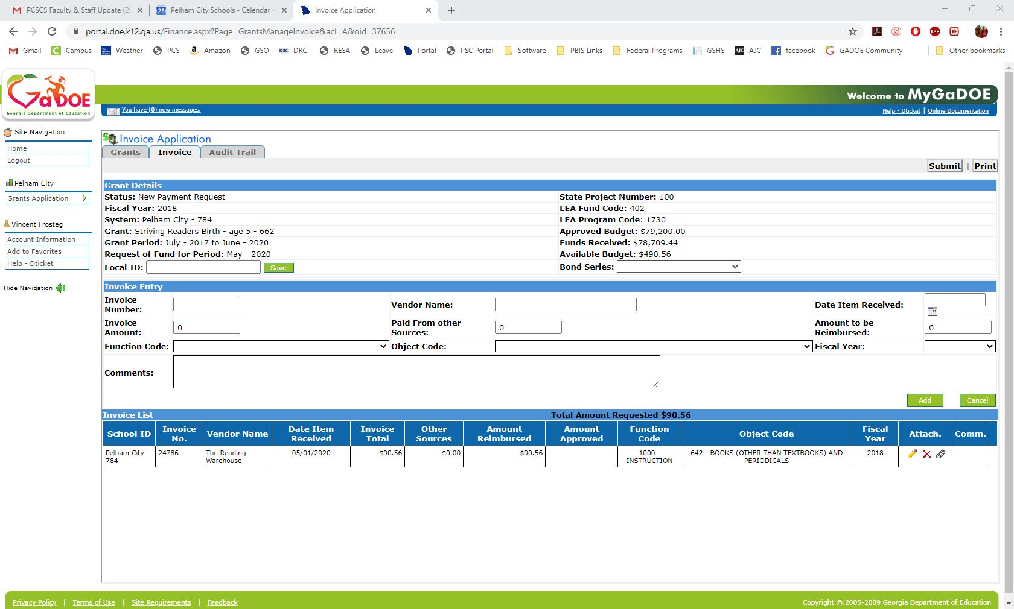
Clicking on view will then allow you to see the individual purchases for the period. The way we do this in Pelham is that I get a PC Genesis report from my finance department of all our purchases. We then go down and check that they match what’s in the invoice application and what’s in my spreadsheet. From this screen, you will also need to check the attachments and make sure that the check copy has been uploaded correctly. (Yes, check it every time. Computers go crazy and DOE won’t accept invoices without supporting attachments.)

Slide 26
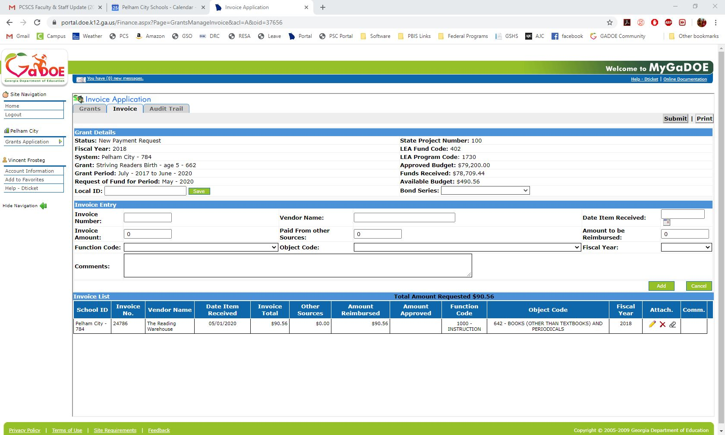
After you’ve checked that the purchases are correct and attachments have been uploaded correctly, you’ll click on submit and affirm that everything is correct.

Slide 27
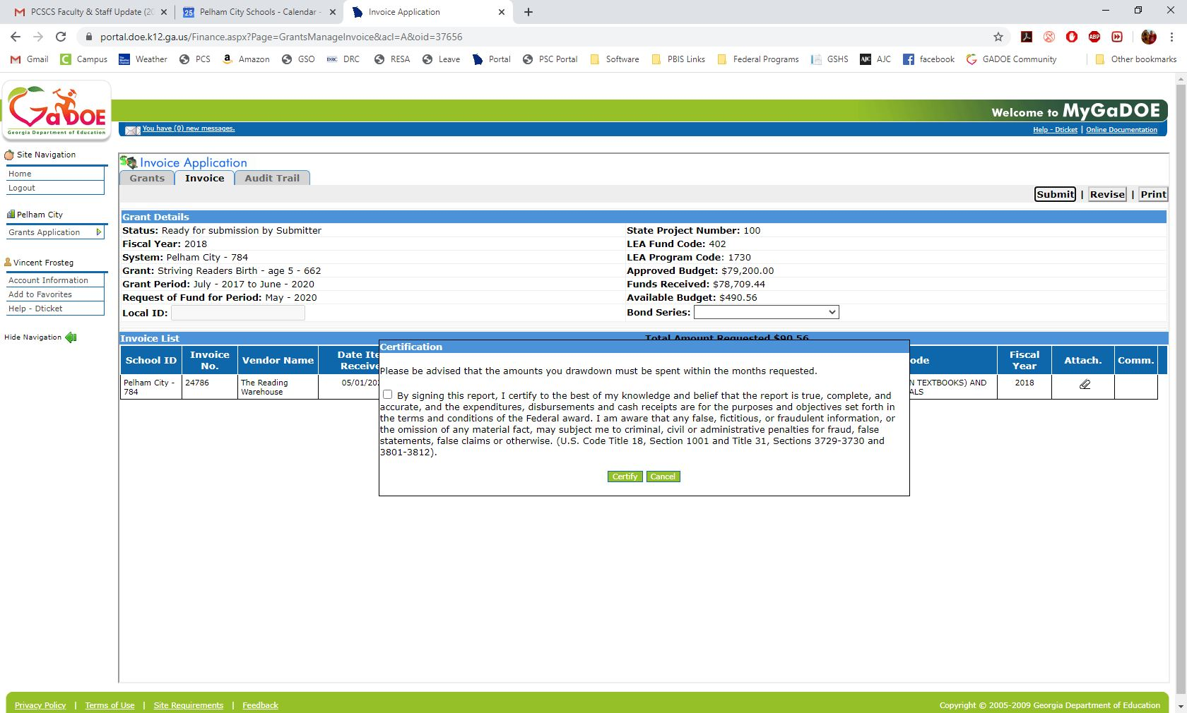
After you’ve checked that the purchases are correct and attachments have been uploaded correctly, you’ll click on submit and affirm that everything is correct.

Slide 28
Let me know if there’s anything I can ever help with! Don’t stress about the ConApp too much—the L4GA people are great and will always let you know if something needs to be corrected.

